Slide 1
Project 1
Ergin Bostanci
Group 1

Slide 2
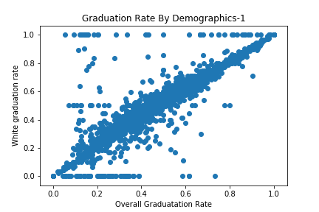
Graduation Rates Compared by Demographics
White - Overall

Slide 3
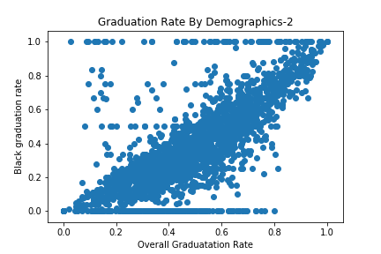
Graduation Rates Compared by Demographics
Black - Overall

Slide 4
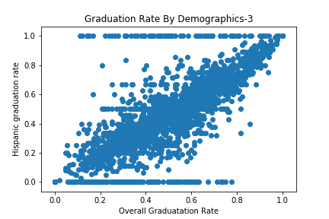
Graduation Rates Compared by Demographics
Hispanic - Overall

Slide 5
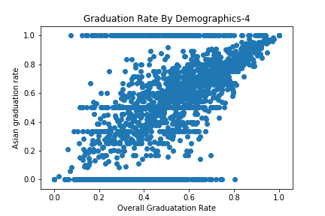
Graduation Rates Compared by Demographics
Asian - Overall

Slide 6
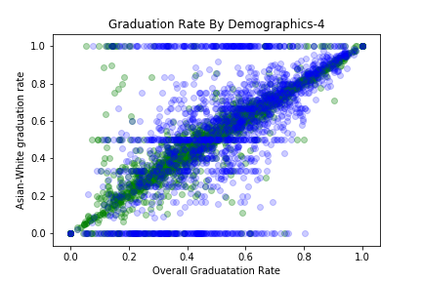
Graduation Rates Compared by Demographics
Asian is
Asian - White

Slide 7
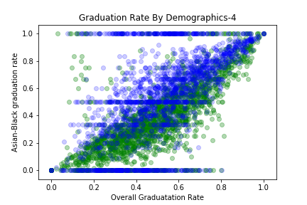
Graduation Rates Compared by Demographics
Asian is
Asian - Black

Slide 8
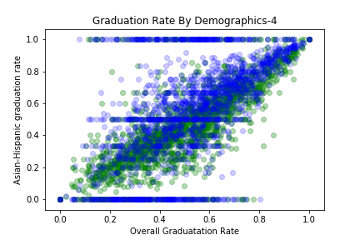
Graduation Rates Compared by Demographics
Asian is
Asian - Hispanic

